Slide 1


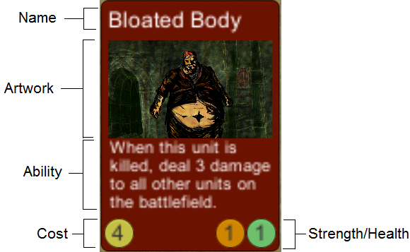

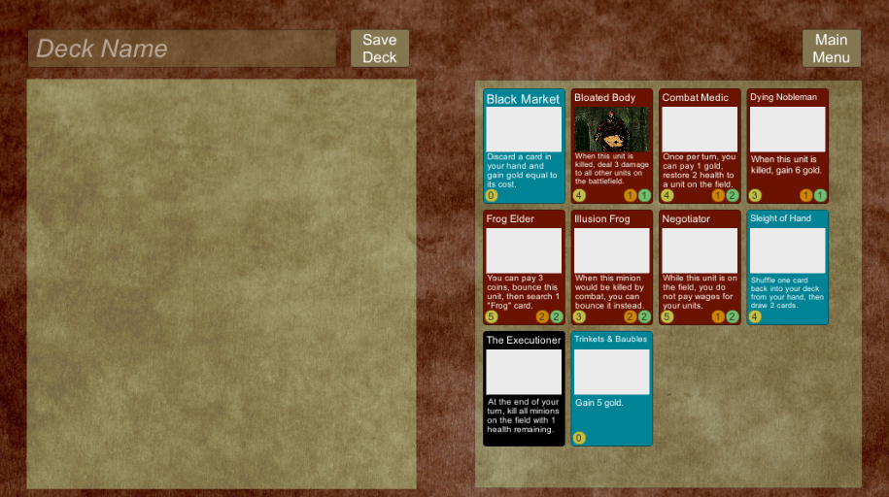
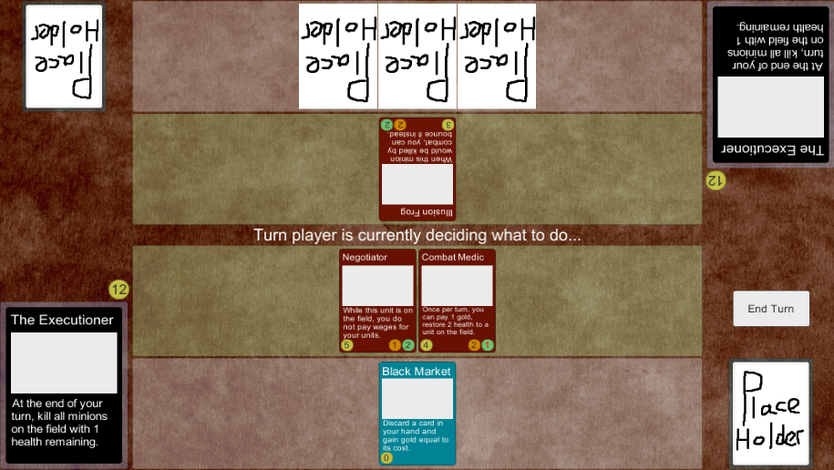

Online Deck-Building Game
Tyler Thorn
Supervisor: Joseph Walton-Rivers
Features
1-on-1 online multiplayer card game with a
Dark fantasy theme.
Resource management.
A wide variety of cards.
Lord cards with powerful abilities that can turn the tide of battle.

